Slide 1



UI/UX DESIGN | PRODUCT MANAGEMENT
BeReal.
BeReal Passport And Community Boards
Enhancement Proposal • 2026
Presented by Lashawn Fofung, MBA, PMP, CSM, CSPO
Notes:
Hi, I’m Lashawn Fofung. This is my case study for BeReal Passport and Community Boards: a feature I designed, prototyped and tested to bring casual users back to BeReal, without adding pressure to post. I’ll walk you through the research, the design, what users told me in testing, and what I’d recommend next.

Slide 2
PROJECT AT A GLANCE
From Teardown To Tested Pitch In Five Steps
01
02
03
04
05
Discover
Define
Design
Prototype & Test
Pitch
BeReal UI/UX teardown and corporate snapshot
Introvert persona and 5-stage journey map
7-screen user flow, UI states and hooks
Clickable prototype, 5-person focus group, survey
Test report, Refine recommendation, pitch video
ROLE
METHODS
TOOLS
OUTCOME
UI/UX designer and product manager (solo project)
Product teardown, persona, journey mapping, usability testing, focus group, survey
Canva, Claude (clickable prototype and promo reel), Google Forms, GitHub Pages
Concept validated with direction: 4 of 5 testers would open BeReal more often. Recommendation: refine, then retest
Live prototype: lashawnfofung.github.io/BeReal-RealProcess
Notes:
Here’s the project at a glance. I worked as both the UI/UX designer and the product manager. The work moved in five steps: a teardown of BeReal, a persona and journey map, the user flow and screens, a clickable prototype tested with five people, and finally a recommendation and pitch. I used Canva for design, Claude to build the clickable prototype and promo reel, Google Forms for the survey, and GitHub Pages to host the prototype. [pause] The short version of the outcome: four of five testers said they’d open BeReal more often.

Slide 3
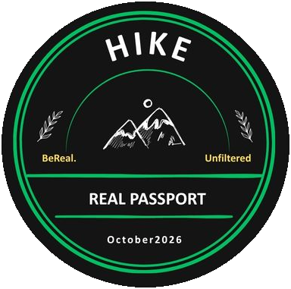

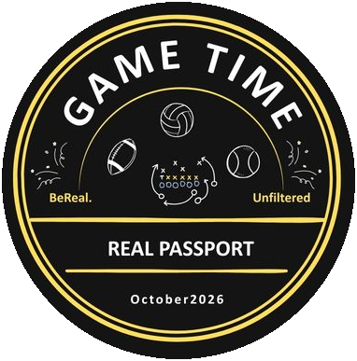

AGENDA
What We’ll Cover
01
02
03
04
Overview & Research
Design
User Testing
Recommendation & Reflection
The problem
Research: where BeReal loses people
The seven-screen user flow
UI states and hooks
Prototype walkthrough
Design decisions
Focus group setup
Survey results
Key findings
Refine, then retest
Staged rollout and metrics
What I learned
Notes:
Here’s how this is organized, in four parts. First, the problem and the research behind it. Second, the design: the user flow, the screens, and the decisions behind them. Third, what happened in user testing. And fourth, my recommendation and what I learned.

Slide 4
PART 1 OF 4
01
Overview & Research
Why people drift away from BeReal, and what the research showed.
01 Overview & Research
02 Design
03 User Testing
04 Recommendation & Reflection
Notes:
Let’s start with the problem, and what the research showed.

Slide 5
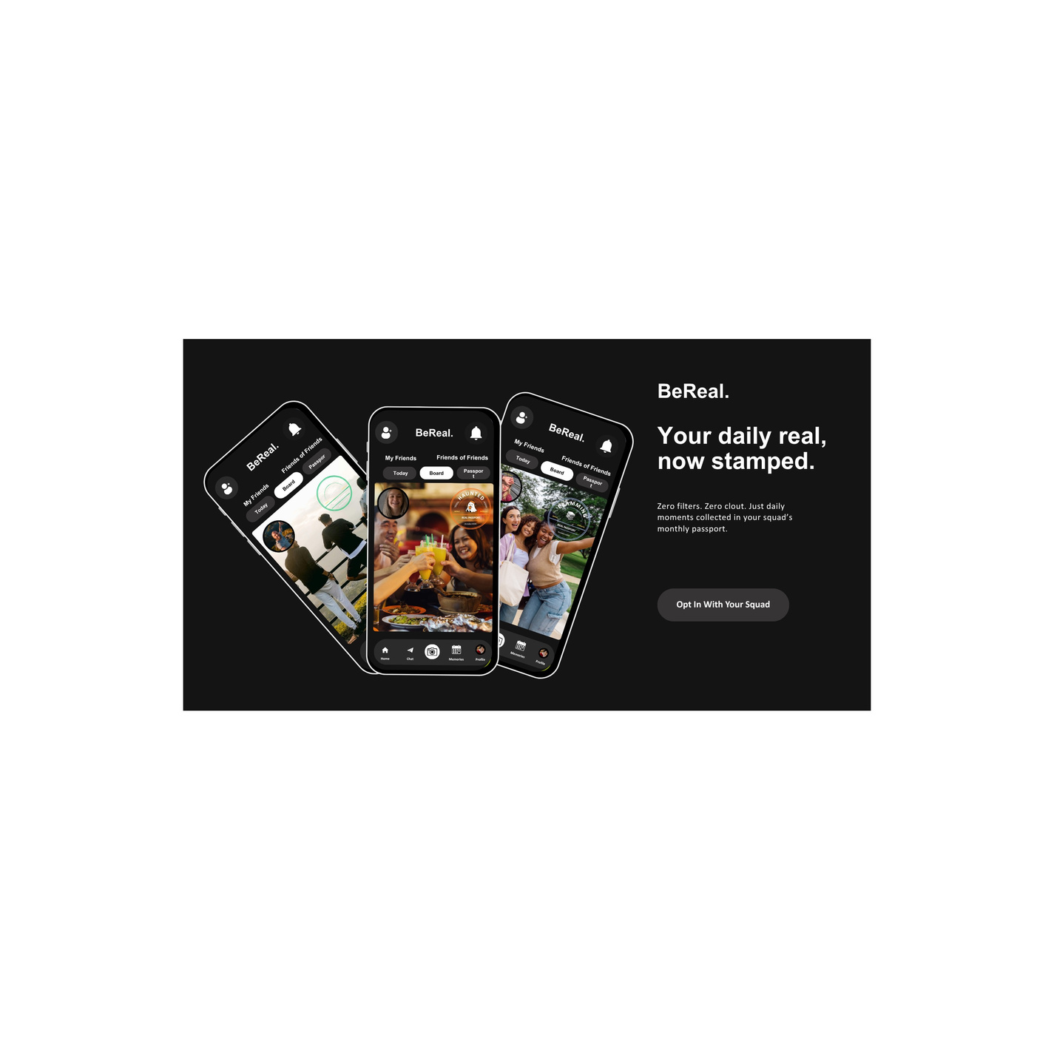
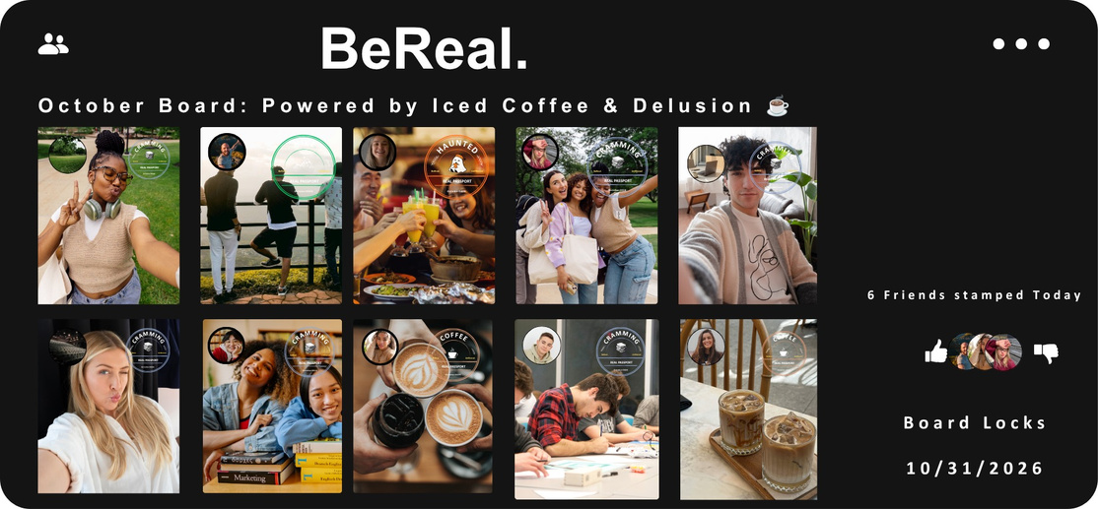
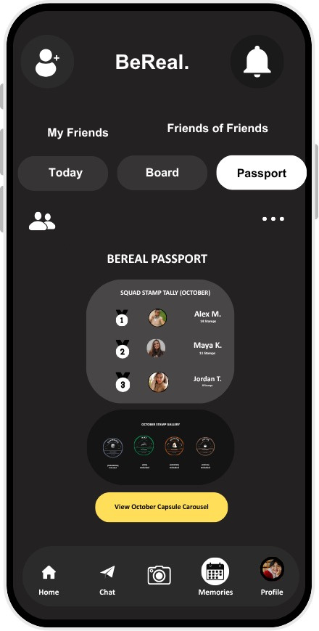

THE INTRO
Driving Authentic Daily Engagement & Long-Term Retention on BeReal.
THE PROBLEM STATEMENT
THE ENHANCEMENT
THE MAU IMPACT
  Post- Notification Slump
  Single-Touchpoint Limit
  Passive Feed Stagnation
  Casual Drop-Off Risk
  Midnight Theme Prompt
  Squad Board Collages
  Vector Passport Stamps
  Monthly Capsule Vault
  2.5x Daily Opens/User
  Organic Peer Accountability
  30-Day Retention Vaulting
  Zero Vanity Metric Loops
Time to Be Real.
Notes:
BeReal’s mission is authentic daily sharing, but it struggles to keep people coming back. I framed four problems: the slump after the notification, a single touchpoint per day, a passive feed, and casual users dropping off. The enhancement answers each one: a midnight theme prompt, squad board collages, collectible passport stamps and a monthly capsule. The 2.5 times daily-opens figure is my target, which I’d validate in an MVP.

Slide 6
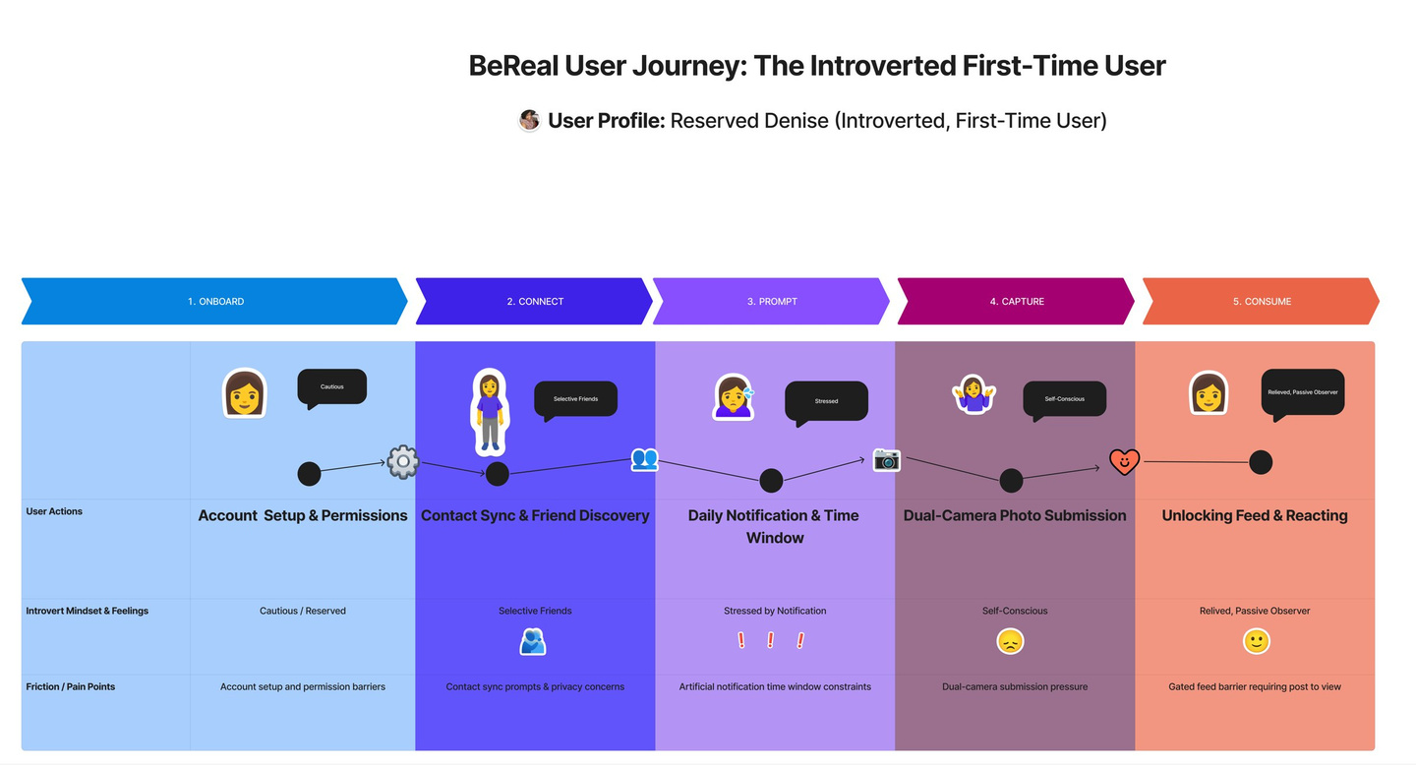
RESEARCH
Where BeReal Loses People
15M → 6M
BeReal daily users, October 2022 to spring 2023 (The New York Times)
“I’m in the middle of working… I wasn’t expecting to take a photo right now.”
Denise, introvert persona, at the prompt stage
WHAT IT MEANT
Pressure points (the 2-minute window, the gated feed) push people away. More urgency won’t win them back; a better reason to post will.
User journey map: introverted first-time user (Onboard → Connect → Prompt → Capture → Consume)
View Image: https://github.com/LashawnFofung/BeReal-RealProcess/blob/main/User%20Journey/BeReal%20User%20Journey%20For%20An%20Introvert%20transparent.png
Notes:
The research backs this up. BeReal’s daily users fell from about 15 million to about 6 million in a matter of months, according to The New York Times. [pause] My journey map follows Denise, an introverted first-time user. At the prompt stage, she feels stressed and put on the spot by the two-minute window, and the gated feed shuts her out unless she posts. My takeaway: more urgency won’t bring people back. They need a better reason to post.
Notation: Source for the daily-user figure: BeReal (Wikipedia), citing The New York Times, “They’re Over Being Real” (April 13, 2023).

Slide 7
PART 2 OF 4
02
Design
A seven-screen habit loop, and the decisions behind it.
01 Overview & Research
02 Design
03 User Testing
04 Recommendation & Reflection
Notes:
Now that we know why people drift away, let’s look at how I designed a better reason to come back.

Slide 8
THE USER FLOW
Seven Screens, One Habit Loop
The 7-screen happy path from start to finish.
1
2
3
4
Today Screen
→
Capture Toggle
→
Board Select
→
Post Confirm
5
6
7
Capsule / Board Detail
→
Passport & Leaderboard
→
Settings / Opt-out
↺ loops back to Today Screen the next day, with a fresh theme
First-time vs. Repeat:
First-time users see a one-time intro overlay on Today Screen; repeat users land directly on the theme hero — no onboarding friction after day one.
Promo Reel: https://youtube.com/shorts/exXoJ6NqmbI
Notes:
I designed a seven-screen habit loop: the Today screen, capture toggle, board select, post confirm, capsule and board details, Passport and leaderboard, and settings. It loops back to the Today screen the next day with a fresh theme. First-time users see a one-time intro; returning users go straight to the boards.

Slide 9
THE PROTOTYPE
A Screen-By-Screen Rundown
Today Screen
Daily theme + reminder bubble + come-back banner
Capture Toggle
Theme Post / Random Post toggle + state demo panel
Board Select
Capsule collage, voting, comments, empty state
Post Confirm
Confirm to post photo to community board or usual post.
Capsule / Board Details
Choose to view capsule collection or see board details.
BeReal Passport
Stamp collection grid + streak cue
Leaderboard
Squad ranking + sponsor banner mockup
Settings / Opt-out
Control settings for name and password. User can opt-out of community board.
Notes:
Here’s what each screen does. Today shows the daily theme, a reminder bubble and a come-back banner. The capture toggle lets you choose a themed post or a regular one. Board select, post confirm, the capsule, the Passport, the leaderboard and settings complete the loop, including the option to opt out of any board.

Slide 10
EMOTIONAL TONE
In Small Amounts, Calm, Real, Human.
“No one’s posted to this board yet — be the first!”
The empty state best captures BeReal’s tone — it would have been easy to leave this as a dead end or a guilt trip. Instead, it stays warm and invitational, the same register BeReal uses everywhere else.
Notes:
Tone mattered as much as features. The empty state says it best: “No one’s posted to this board yet — be the first!” It would have been easy to make that a dead end or a guilt trip. Instead, it stays warm and inviting, the way BeReal talks everywhere else.

Slide 11
UI STATES COVERED
Designed For More Than The Happy Path
What happens when things are empty, loading , or go wrong.
🌱
⏳
🎉
⚠️
Empty
Loading
Success
Error
Board Selection / Capsule
Post Confirmation
Post Confirmation
Post Confirmation
“No one’s posted to this board yet — be the first!”
“Stamping your passport…”
“Stamp earned! Added to Coffee Shop 🎉”
“That didn’t go through — let’s try again.”
Notes:
Beyond tone, I designed for more than the happy path: empty, loading, success and error. Each state has its own message, from “Stamping your passport…” to “That didn’t go through — let’s try again.”

Slide 12
MAU-ORIENTED HOOKS
Invite People Back, Never Pressure Them
👀
🔆
⏰
Reminder Bubble
Soft Streak Cue
Come-back Banner
“3 friends already posted to Coffee Shop today”
“You’ve been real 3 days in a row”
“Come back tomorrow for a new theme”
Social curiosity, not an alert
No loss framing, no streak-breaking guilt
Sets up tomorrow’s open without pushing it
BACK CAMERA — FULL FRAME FRONT CAMERA — OVERLAY
Notes:
These are the hooks that bring people back, built to invite rather than pressure. A reminder bubble sparks curiosity: “3 friends already posted to Coffee today.” A soft streak cue has no loss framing. And a come-back banner sets up tomorrow without pushing.

Slide 13


FEATURE CONCEPT - OCTOBER 2026
BeReal.
BeReal.
BEREAL PASSPORT & COMMUNITY BOARDS
My Friends
Friends of Friends
Today
Board
Passport
Your daily BeReal,
now stamped.
Collect everyday moments with your squad. Create a shared monthly board, unlock playful passport stamps, and save the months as a capsule. No public likes. No filters. Just your people.
01 • Capture First
02 •Pick a Board
03 •Collect Stamps
04 •Archive Together
Prototype flow: Try to capture button, choose a community board after the photo, react to a board moment, and explore the Octorber Passport and Vault.
DESIGN PRINCIPLES
Home
Chat
Memories
Profile
Pitch-black canvas • Candid dual-camera feel • Tactile pastel stamp ink • Private squad reactions • Monthly collection loop
Interactive Prototype: https://claude.ai/artifact/QouixAtcmRQXoxXEiUsXgm
or
https://lashawnfofung.github.io/BeReal-RealProcess/
Notes:
Here’s the concept in one line: your daily BeReal, now stamped. You capture first, pick a board, collect a stamp, and archive the month together. The design principles are a pitch-black canvas, the candid dual-camera feel, tactile stamp ink, private squad reactions, and a monthly collection loop.

Slide 14
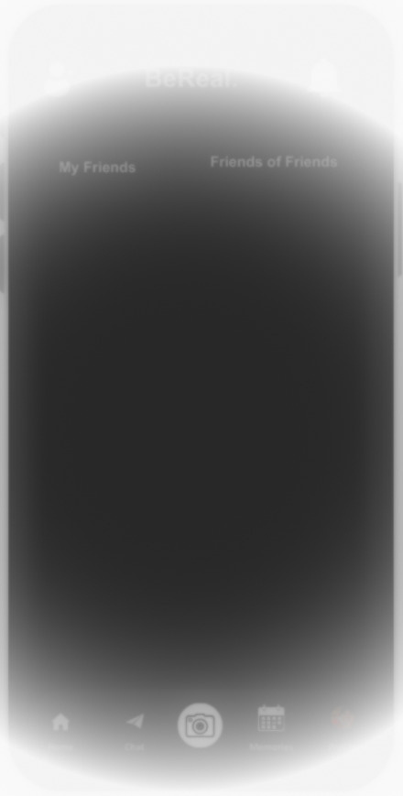


FEATURE CONCEPT - OCTOBER 2026
BeReal.
BeReal.
BeReal.
BEREAL PASSPORT & COMMUNITY BOARDS
My Friends
Friends of Friends
My Friends
Friends of Friends
Today
Board
Passport
Today Screen
(New User)
Opt-in to join Community Boards
⚠️ 12:00 AM Community Board open!!
Capture a moment to get your BeReal Passport.
Take a photo → Choose a Community Board → Real Passport Stamp added and posted to community board.
  User will receive an alert prompt at 12:00 AM their local time.
    Specific time to reset for tracking
  User opens app at their convenience
    Not dependent of Timed posting
  1 of 3 New Views for feature
  A button for user to opt-in to join Community Boards
    Opt-out default if user does not opt-in
To view your friends’ BeReal, share yours with them.
Post A BeReal.
To view your friends’ BeReal, share yours with them.
Post A BeReal.
Home
Chat
Memories
Profile
Home
Chat
Memories
Profile
User Receives Daily Alert
User Opens App
Notes:
Let’s walk through the flow. A new user gets an alert at 12:00 AM local time when the month’s boards open. It isn’t a timed post; they open the app whenever it suits them. Community Boards are opt-in, so nothing changes unless they choose to join.

Slide 15

FEATURE CONCEPT - OCTOBER 2026
BeReal.
BeReal.
BeReal.
BEREAL PASSPORT & COMMUNITY BOARDS
Capture Toggle
Add a caption...
  User takes a photo
  Choose Post Type
    SEND
      Random Post
      No BeReal Passport
    COMMUNITY BOARD
      Themed Post
      Adds BeReal Passport to post
My Friends
ON
VIDEO
PHOTO
SEND
COMMUNITY
BOARD
User Takes Photo
Add Caption & Choose Post Type
Notes:
After taking a photo, the user chooses the post type. SEND is a regular post with no passport. COMMUNITY BOARD is a themed post that adds a stamp. The board choice comes after the photo, so capturing stays as fast as it is today.

Slide 16
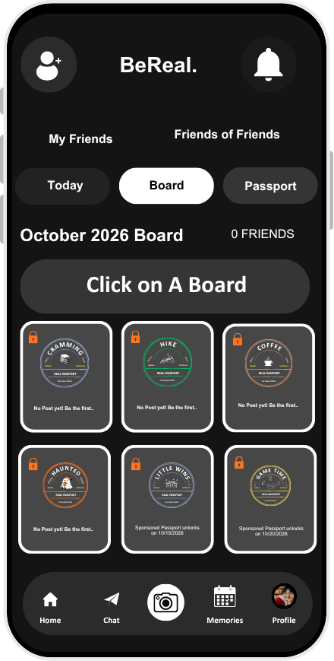
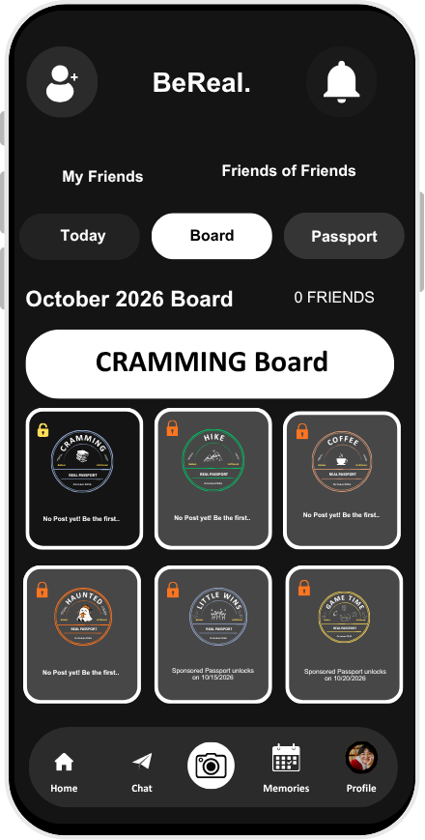
FEATURE CONCEPT - OCTOBER 2026
BeReal.
BEREAL PASSPORT & COMMUNITY BOARDS
Board Select
  Directed from Capture Screen to Board Screen
  User Chooses A Board
    Visual Confirmation
    Highlighted card switch from grey to white with name of selected board.
    Key Icon Changes from Lock to Unlock
User Chooses A Board
Board Chosen
Notes:
Next, they pick a board. The selected card switches from grey to white with the board’s name, and its lock icon changes to unlocked, so the choice is confirmed at a glance.

Slide 17
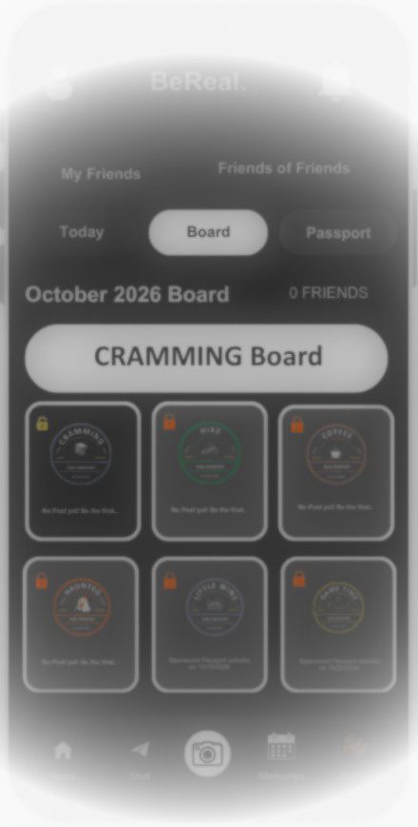
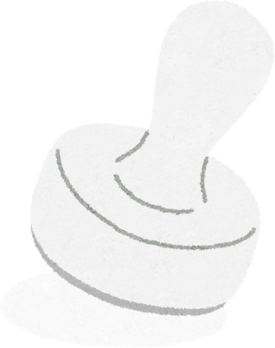

FEATURE CONCEPT - OCTOBER 2026
BeReal.
BeReal.
BeReal.
BEREAL PASSPORT & COMMUNITY BOARDS
My Friends
Friends of Friends
My Friends
Friends of Friends
Today
Board
Passport
Today
Board
Passport
Post Confirm
October 2026 Board
0 FRIENDS
October 2026 Board
0 FRIENDS
CRAMMING Board
CRAMMING Board
  Happy path messages:
    Loading
      “Stamping your passport..”
    Success
      “Stamp earned! Added to CRAMMING board🎉”
  If something goes wrong, a message will display:
    Empty state
      “No one’s posted to this board yet - be the first!”
    Error state
      “⚠️ That didn’t go through. Let’s try again.”
Stamping your passport..
Stamp earned! Added to CRAMMING board 🎉
CRAMMING
HIKE
COFFEE
CRAMMING
HIKE
COFFEE
BeReal.
REAL PASSPORT
Unfiltered
BeReal.
REAL PASSPORT
Unfiltered
BeReal.
REAL PASSPORT
Unfiltered
BeReal.
REAL PASSPORT
Unfiltered
BeReal.
REAL PASSPORT
Unfiltered
BeReal.
REAL PASSPORT
Unfiltered
October2026
October2026
October2026
October2026
October2026
October2026
No Post yet! Be the first..
No Post yet! Be the first..
No Post yet! Be the first..
No Post yet! Be the first..
No Post yet! Be the first..
No Post yet! Be the first..
HAUNTED
LITTLE WINS
GAME TIME
HAUNTED
LITTLE WINS
GAME TIME
BeReal.
REAL PASSPORT
Unfiltered
BeReal.
REAL PASSPORT
Unfiltered
BeReal.
REAL PASSPORT
Unfiltered
BeReal.
REAL PASSPORT
Unfiltered
BeReal.
REAL PASSPORT
Unfiltered
BeReal.
REAL PASSPORT
Unfiltered
October2026
October2026
October2026
October2026
October2026
October2026
No Post yet! Be the first..
Sponsored Passport unlocks on 10/15/2026
Sponsored Passport unlocks on 10/20/2026
No Post yet! Be the first..
Sponsored Passport unlocks on 10/15/2026
Sponsored Passport unlocks on 10/20/2026
Home
Chat
Memories
Profile
Home
Chat
Memories
Profile
Loading
Success
Notes:
Post confirm covers every state: a loading message, “Stamping your passport…”, then “Stamp earned! Added to the Cramming board.” If something goes wrong, the error message invites them to try again.

Slide 18
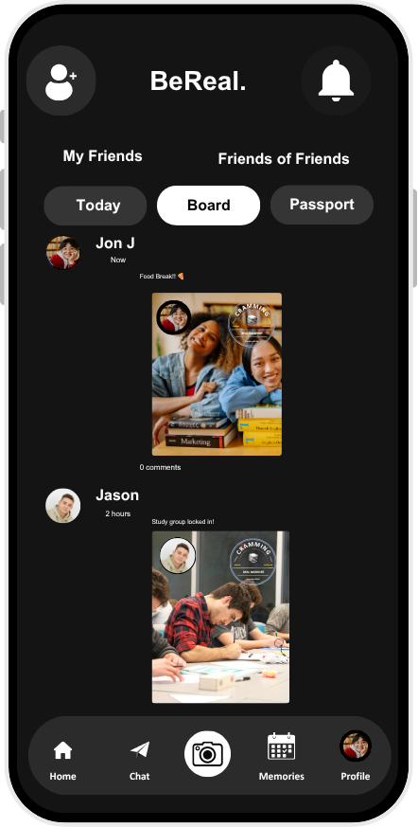
FEATURE CONCEPT - OCTOBER 2026
BeReal.
BEREAL PASSPORT & COMMUNITY BOARDS
Post Confirm
  Post added in Cramming Community Board feed
  User will see BeReal Passport stamp added to their photo
  User will be able to view other user’s community board post with BeReal Passport stamp
Notes:
The post then lands in the Cramming board feed with its passport stamp, alongside friends’ stamped posts.

Slide 19
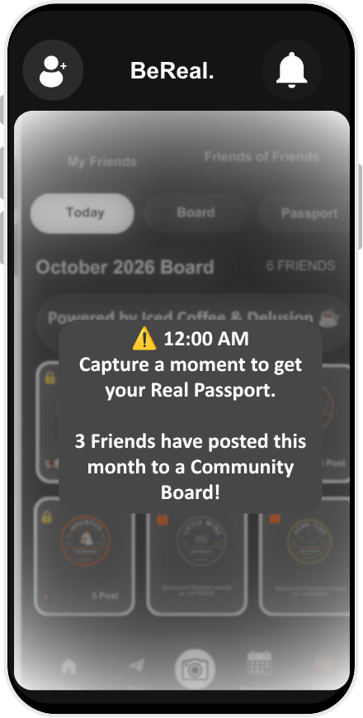
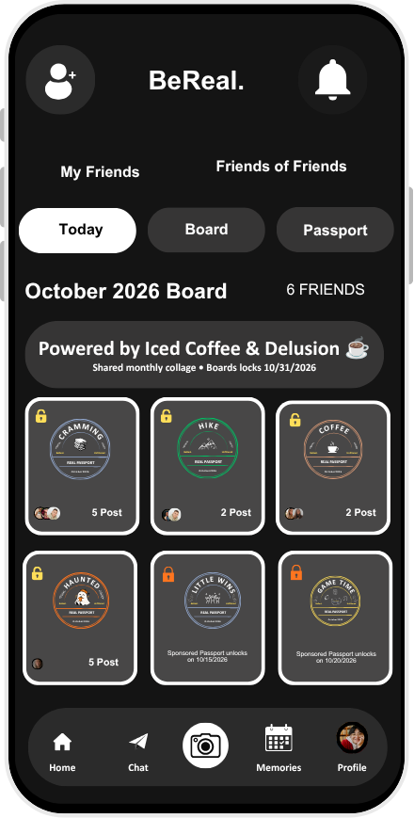
FEATURE CONCEPT - OCTOBER 2026
BeReal.
BEREAL PASSPORT & COMMUNITY BOARDS
Today Screen
(Returning User)
  MAU increase
  Daily Prompt
  Reminders
    Friends Posted to Board
    Streaks
    Comeback banner
  Once user has opt-in to join 1 or more community boards, ‘Today Screen’ will show October snapshot.
  Snapshot view of all the community boards available for the month (themed & sponsored)
  Each community board snapshot shows:
    State (locked or unlocked)
    Image of Real Passport stamp
    Friends who have posted
    Number of Post
Daily Prompt
Snapshot
Notes:
Returning users see the month’s snapshot: every board, themed and sponsored, with its lock state, its stamp, the friends who’ve posted and the number of posts, plus a daily prompt.

Slide 20
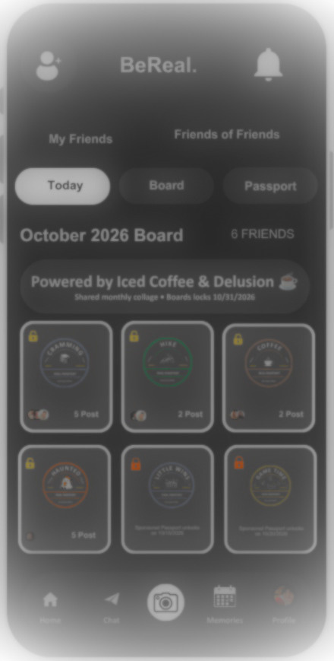
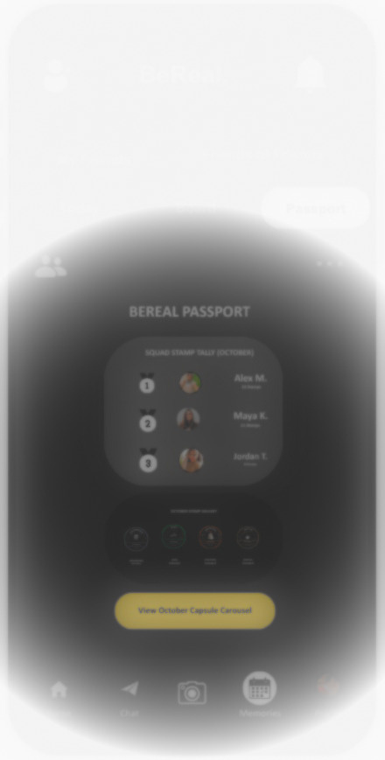


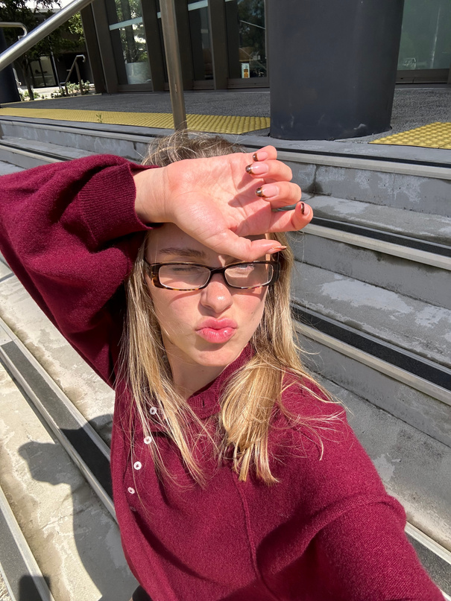







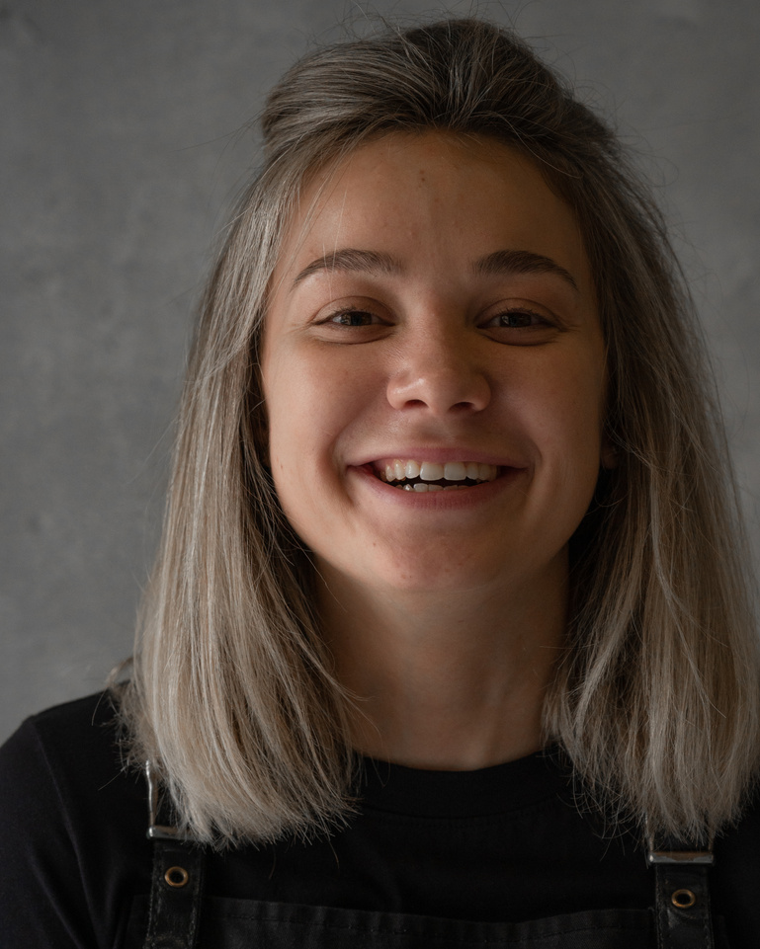
FEATURE CONCEPT - OCTOBER 2026
BeReal.
BeReal.
BeReal.
BEREAL PASSPORT & COMMUNITY BOARDS
My Friends
Friends of Friends
My Friends
Friends of Friends
Reminders
Today
Board
Passport
Today
Board
Passport
SUN Oct 18
October 2026 Board
6 FRIENDS
October 2026 Board
6 FRIENDS
  MAU increase
  Reminders
    Friends Posted to Board
      Social curiosity
    Streaks
      No loss framing
      No streak-breaking guilt
    Comeback banner
      Sets up for tomorrow’s engagement
  No pressure to post
8:33
Powered by Iced Coffee & Delusion ☕️
Shared monthly collage • Boards locks 10/31/2026
Powered by Iced Coffee & Delusion ☕️
Shared monthly collage • Boards locks 10/31/2026
☀️
You’ve been real 3 days in a row
⏰
Come back tomorrow for a new BeReal Passport
CRAMMING
HIKE
COFFEE
CRAMMING
HIKE
COFFEE
BeReal.
REAL PASSPORT
Unfiltered
BeReal.
REAL PASSPORT
Unfiltered
BeReal.
REAL PASSPORT
Unfiltered
BeReal.
REAL PASSPORT
Unfiltered
BeReal.
REAL PASSPORT
Unfiltered
BeReal.
REAL PASSPORT
Unfiltered
Notification Center
October2026
October2026
October2026
October2026
October2026
October2026
5 Post
2 Post
2 Post
5 Post
2 Post
2 Post
👀
3 Friends Have Posted To CRAMMING Board
HAUNTED
LITTLE WINS
GAME TIME
HAUNTED
LITTLE WINS
GAME TIME
BeReal.
REAL PASSPORT
Unfiltered
BeReal.
REAL PASSPORT
Unfiltered
BeReal.
REAL PASSPORT
Unfiltered
BeReal.
REAL PASSPORT
Unfiltered
BeReal.
REAL PASSPORT
Unfiltered
BeReal.
REAL PASSPORT
Unfiltered
October2026
October2026
October2026
October2026
October2026
October2026
5 Post
Sponsored Passport unlocks on 10/15/2026
Sponsored Passport unlocks on 10/20/2026
5 Post
Sponsored Passport unlocks on 10/15/2026
Sponsored Passport unlocks on 10/20/2026
Home
Chat
Memories
Profile
Home
Chat
Memories
Profile
Soft Streak Cue
Come-back Banner
Reminder Bubble
Notes:
Here are the three reminders in context: a notification that friends have posted, a soft streak cue, and a come-back banner. None of them uses loss framing.

Slide 21



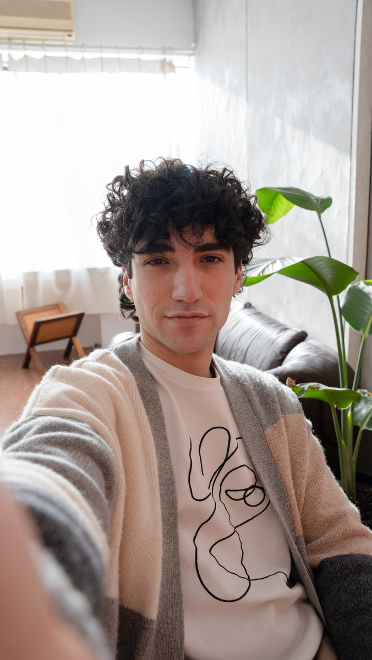
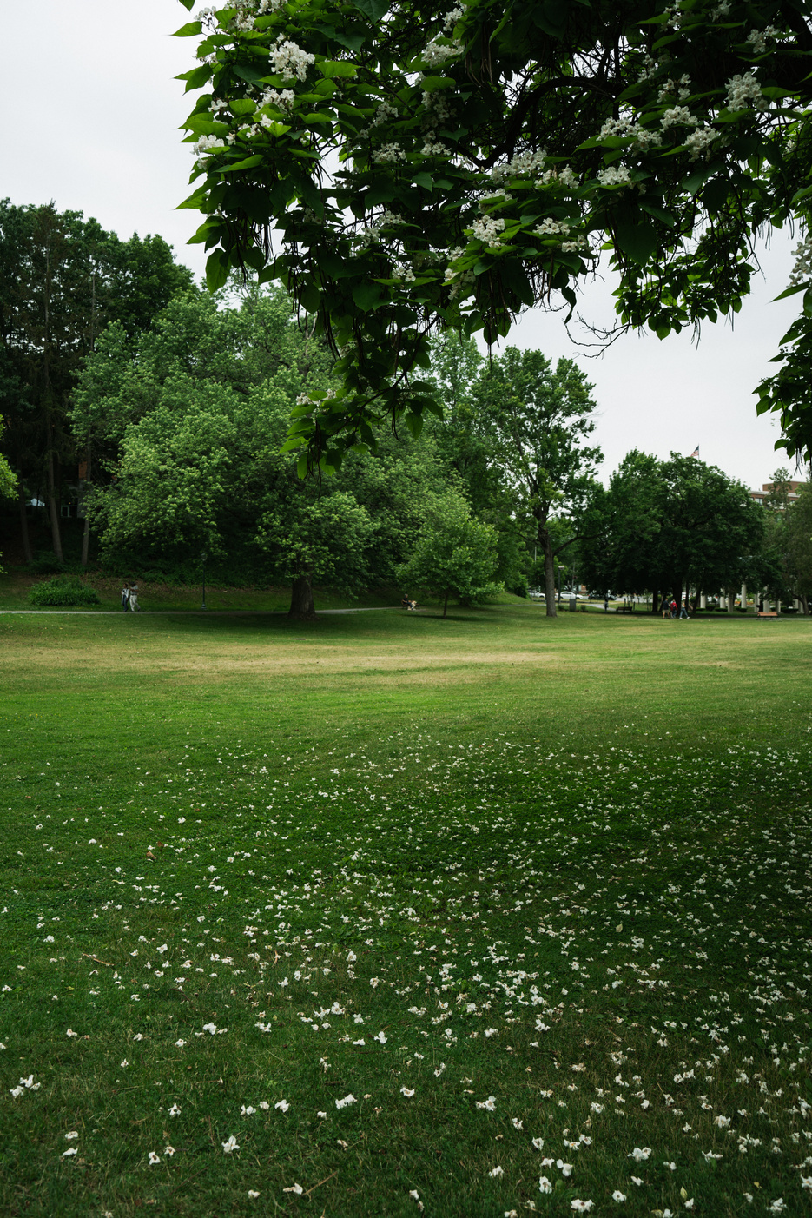

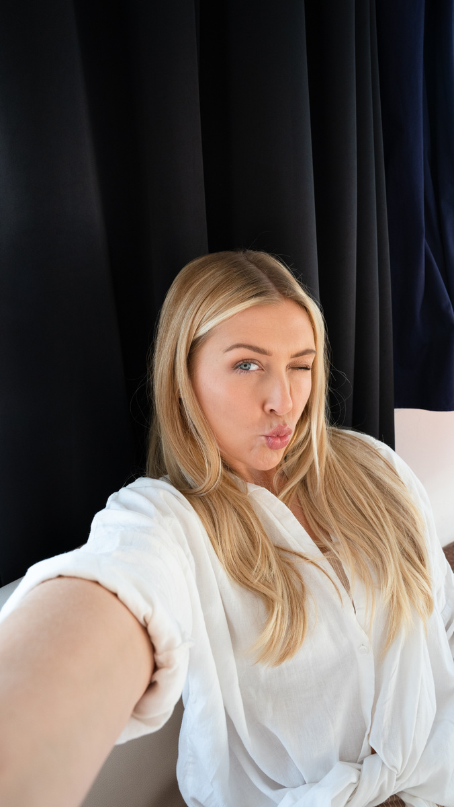


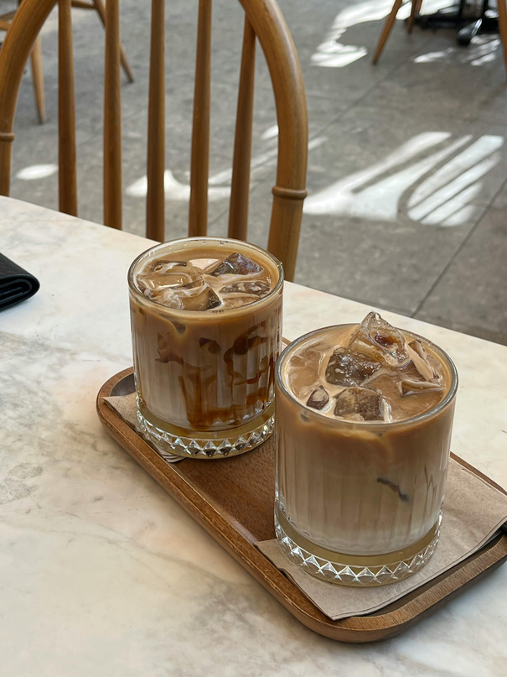
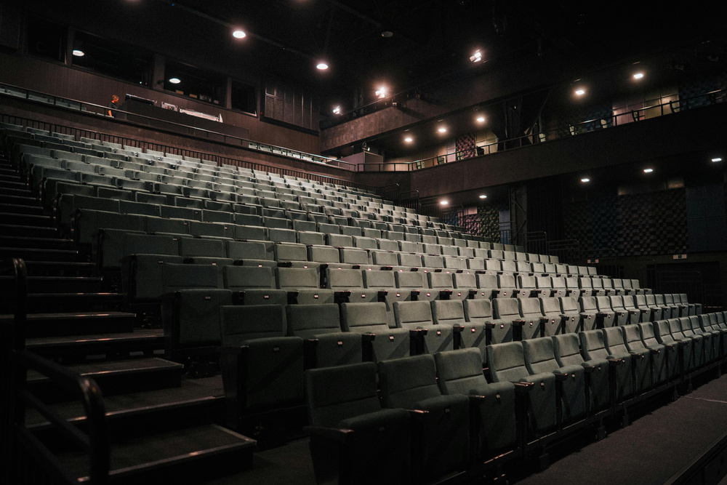
FEATURE CONCEPT - OCTOBER 2026
BeReal.
BeReal.
BEREAL PASSPORT & COMMUNITY BOARDS
My Friends
Friends of Friends
Capsule / Board Details
Today
Board
Passport
October 2026 Board: Powered by Iced Coffee & Delusion ☕️
  MAU increase
  Past Boards are stored in ‘Memories’ as a Capsule
    View all Community Boards Posting in a carousel view
  Carousel View
    Snapshot
    Expand out
      User can click on image to view post
      Future Enhancement
        2-Column Grid scroll
  Board details shows:
    Friends who participated
    Number of Likes or Dislikes
CRAMMING
HIKE
HAUNTED
CRAMMING
CRAMMING
BeReal.
REAL PASSPORT
Unfiltered
BeReal.
Unfiltered
BeReal.
Unfiltered
BeReal.
Unfiltered
BeReal.
Unfiltered
October2026
REAL PASSPORT
REAL PASSPORT
REAL PASSPORT
REAL PASSPORT
October2026
October2026
October2026
October2026
CRAMMING
CRAMMING
COFFEE
CRAMMING
COFFEE
BeReal.
REAL PASSPORT
Unfiltered
BeReal.
REAL PASSPORT
Unfiltered
BeReal.
REAL PASSPORT
Unfiltered
BeReal.
REAL PASSPORT
Unfiltered
BeReal.
REAL PASSPORT
Unfiltered
October2026
October2026
October2026
October2026
October2026
6 Friends stamped Today
Board Locks 10/31/2026
Home
Chat
Memories
Profile
Notes:
When a month ends, its board is saved to Memories as capsules. You can browse them as a carousel or a collage, open any post, and see who took part.

Slide 22

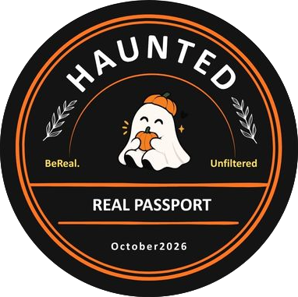




FEATURE CONCEPT - OCTOBER 2026
BeReal.
October 2026 Release
BEREAL PASSPORT & COMMUNITY BOARDS
BeReal Passport
  MAU increase
  New Theme Designs released monthly
  Sponsored Ad designs
  Gamified engangement
    Leadership board
  User can view their BeReal Passport Collection on the ‘Passport’ tab
Notes:
Then there’s the Passport itself: the collection. New stamp designs launch every month, including sponsored ones, which opens a future monetization path. The whole collection lives in its own Passport tab.

Slide 23

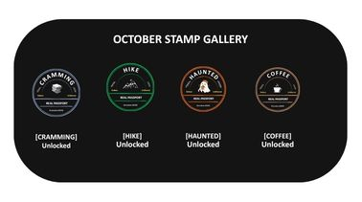
Leadership Board
FEATURE CONCEPT - OCTOBER 2026
BeReal.
SQUAD STAMP TALLY (OCTOBER)
Alex M.
14 Stamps
BEREAL PASSPORT & COMMUNITY BOARDS
Maya K.
11 Stamps
Leaderboard
Jordan T.
8 Stamps
  MAU Increase
  Design for push notification landing pages and in-app feature announcements.
  Leadership Board
  Passport Collection
  Quick Link to Capsule Carousel
User BeReal Passport
Collection
Button to Take User to Memories
View October Capsule Carousel
Notes:
Alongside the collection, the leaderboard shows a squad stamp tally, your collection, and a quick link to the capsule carousel. It also works as a landing page for notifications and feature announcements.

Slide 24


FEATURE CONCEPT - OCTOBER 2026
BeReal.
Settings
Settings
BEREAL PASSPORT & COMMUNITY BOARDS
Jon
Jon
Jon J
Jon J
Settings / Opt-out
FEATURES
Audio
Opt-in - Community Board
Opt-out - Community Board
COMMUNITY BOARD
  Manage Community Board(s) Participation
    Easily Opt-in or Opt-out
    Updated Setting Screen
    New screen to easily add or remove
SETTINGS
You can only opt-in or opt-out of current boards.
Choose board(s).
Notifications
CRAMMING
CRAMMING
ON
OFF
BeReal.
REAL PASSPORT
Unfiltered
Privacy
October2026
HIKE
BeReal.
HIKE
Unfiltered
ON
OFF
REAL PASSPORT
Email
ON
October2026
COFFEE
BeReal.
COFFEE
Unfiltered
ON
OFF
REAL PASSPORT
Time Zone: Americas
October2026
HAUNTED
HAUNTED
ON
OFF
BeReal.
REAL PASSPORT
Unfiltered
Other
October2026
GAME TIME
GAME TIME
ON
OFF
BeReal.
REAL PASSPORT
Unfiltered
ABOUT
October2026
LITTLE WINS
LITTLE WINS
ON
OFF
BeReal.
REAL PASSPORT
Unfiltered
👀
Share BeReal.
October2026
Rate BeReal.
Help
About
Log Out
Opt-in (Join)
or
Opt-out (Leave)
Version 4.99.2AB
Home
Chat
Memories
Profile
User Selects
Select Board(s)
Notes:
And settings let users opt in or out of each board at any time, so they’re always in control.

Slide 25
DESIGN DECISIONS
Key Decisions And Their Trade-offs
DECISION
WHY
TRADE-OFF
Pick a board after the photo
Capture stays instant, exactly like BeReal today
One extra step; testers noticed the taps
Opt-in only
No one is pushed into boards; random posts still work
Smaller reach at launch
Squad-only reactions, no public likes
Avoids performance and vanity metrics
Less viral spread
Hooks that invite, never guilt
No loss framing, no streak-breaking shame
A softer nudge than classic streaks
Monthly boards that close into a capsule
A keepsake, not an endless treadmill
Content resets every month
Notes:
Behind these screens were some deliberate trade-offs. I put the board choice after the photo to keep capture instant, at the cost of an extra step, which testers did notice. Boards are opt-in only, which protects the experience but limits reach at launch. Reactions stay inside the squad, with no public likes. Hooks invite instead of guilt, which is a softer nudge than classic streaks. And boards close every month, so they become a keepsake, not a treadmill.

Slide 26
WHY THIS STILL FEELS LIKE BEREAL
Additive, Not Addictive
Same real photo
Opt-in only
No filters, no retakes, no new content requirement , and tagging is a layer on top.
Random, untagged posting stays fully supported for anyone who ignores boards.
Time-boxed
No shame mechanics
Boards close at month end and become a keepsake, not an infinite treadmill.
Stamps and the leaderboard reward participation, no streak-loss messaging.
Notes:
That’s why I’d argue it still feels like BeReal: it’s additive, not addictive. Same real photo, opt-in only, time-boxed, and no shame mechanics.

Slide 27
PART 3 OF 4
03
User Testing
Five people, three tasks, one survey: what users actually did and said.
01 Overview & Research
02 Design
03 User Testing
04 Recommendation & Reflection
Notes:
A design is only a guess until real people use it. [pause] So let’s see what happened when I put it in front of users.

Slide 28
USER TESTING
Five People, 40 Minutes, Three Tasks
WHO TOOK PART
HOW THE SESSION RAN
1
Warm-up 5 min
1
Daily User
Uses BeReal most days
How often people open and post on BeReal today.
2
Prototype Tasks 15 min
2
Respond to the 12:00 AM alert and post; find this month's stamps; explore the streak and leaderboard. Participants thought aloud.
Occasional Users
A few times a month
3
Debrief 15 min
Interest, clarity, and whether it feels more or less like BeReal.
2
Rare Users
Rarely or never
4
Survey 5 min
8 questions: usage, four 1–5 scales, launch yes/maybe/no, two open-ended.
In person · October 2026 · clickable prototype, observer notes and a Google Form
Notes:
I ran a 40-minute, in-person focus group with five people: one daily user, two occasional users, and two who rarely use BeReal. They completed three tasks while thinking aloud, then we discussed it and they took an eight-question survey.

Slide 29
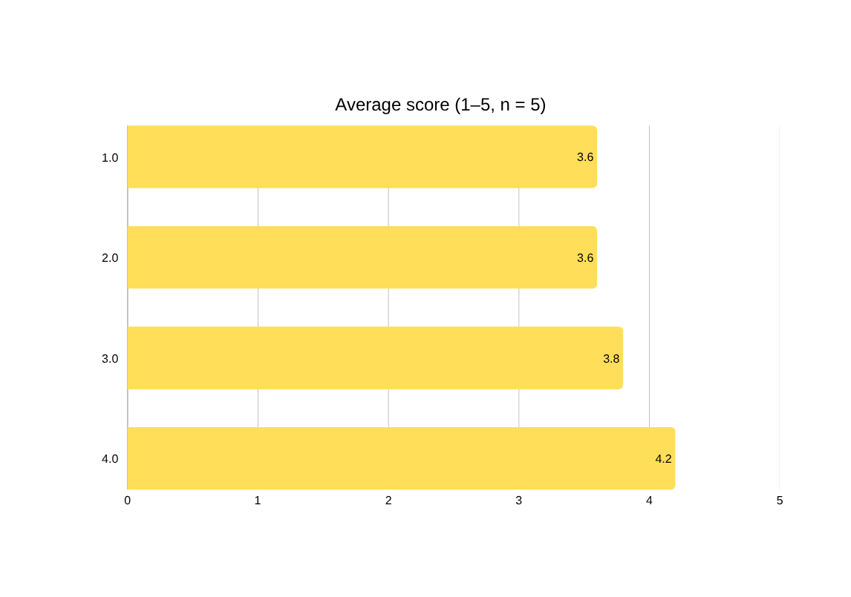
SURVEY RESULTS
4 of 5 Would Open BeReal More Often
4 of 5
rated 4 or 5 for understanding, authenticity and opening BeReal more often
4.2 / 5
hooks felt low-pressure, the highest score; no one rated them below 3
3 · 1 · 1
Yes · Maybe · No to launching the feature
One non-user rated the first three questions 1. Without that response they average 4.25, 4.25 and 4.5.
Notes:
Four of five said they’d open BeReal more often. [pause] And the reminders, streak and leaderboard scored 4.2 out of 5 for feeling low-pressure, the highest score of all. [pause] Three would launch it, one said maybe, and one said no.

Slide 30
KEY FINDINGS
What We Learned
1 · MAU SIGNAL
2 · USABILITY
Brings back occasional users
Too many taps from capture to post
“I'd definitely open the app more often because of this.”
“There are a few too many button clicks in this flow.”
Both occasional users rated “open more often” a 5
Raised twice in the session and again in the survey
3 · VALUE
4 · AUTHENTICITY
Stamps and the Passport are the draw
No pressure, but complexity hurts fit
“The passport stamp designs themselves look really cool!”
“It feels less authentic and overly complex.”
Most-liked: layout, stamps, navigation, community posting
Hooks scored 4.2 / 5 for low pressure; one non-user found it complex
Notes:
Four findings stood out. It brings back occasional users. The capture-to-post flow had too many taps. The stamps and the Passport were the draw. And the risk wasn’t pressure; it was complexity. The one non-user said it felt “less authentic and overly complex.”

Slide 31
PART 4 OF 4
04
Recommendation &
Reflection
What BeReal should do next, and what I learned along the way.
01 Overview & Research
02 Design
03 User Testing
04 Recommendation & Reflection
Notes:
So what should BeReal do with these results? Here’s my recommendation, and what I learned along the way.

Slide 32
RECOMMENDATION
Refine, Then Retest
PROCEED · REFINE · PIVOT
1
Cut Taps from Capture to Stamp
Most repeated issue
Remember the last board used, or pick a board right on the compose screen.
Refine
2
Make SEND vs COMMUNITY BOARD Clear
“Not sure which one does what”
Keep the concept. Users valued the stamps, Passport and squad boards, and the hooks added no pressure. Fix the friction before a wider test.
Add a one-line hint the first time someone sees the choice.
3
Add a First-use Explainer
A non-user didn't see the point
One screen for people new to boards.
Retest with 7–10 people, including more non-users. Measure taps and time from capture to a stamped post.
4
Keep Hooks Optional, Same Tone
Highest survey score (4.2 / 5)
They already read as motivating.
Notes:
My recommendation is to refine, then retest. Keep the concept. Cut the taps from capture to stamp, make the SEND versus COMMUNITY BOARD choice clear, add a first-use explainer, and keep the hooks as they are.

Slide 33
RECOMMENDATIONS
A Staged Rollout, Starting Small
Phase 0
Phase 1
Phase 2
Phase 3
Phase 4
Prototype & Test
Refine & Retest
MVP
Full Rollout
Monetization (pilot)
Done. Clickable prototype tested with 5 people; 4 of 5 would open BeReal more often.
Fewer taps, clearer post type, first-use explainer. Retest with 7–10 people.
1–2 boards, one friend-group cohort. Measure adoption and DAU/MAU lift.
4–5 concurrent monthly boards. Passport and leaderboard shipped in full.
Explore sponsor-branded boards, subject to brand-safety review.
COMPLETE
NEXT
Decision Needed
Approve a short refine-and-retest sprint, then a limited MVP with one friend-group cohort and one board to validate the MAU hypothesis before further engineering investment.
Notes:
From there, a staged rollout. Phase 0, prototype and test, is complete. Phase 1 refines and retests with seven to ten people. Phase 2 is an MVP with one friend group, then a full rollout, and later a sponsored-board pilot.

Slide 34
SUCCESS METRICS & PRIORITIZATION
What We’ll Watch, and Why This Ranks High
Success Metrics
RICE Snapshot (indicative)
  DAU / MAU ratio (stickiness)
  Daily open rate
  D7 and D30 retention
  % of posts tagged to a board
  Passport / leaderboard visits
  Taps and time from capture to stamped post (new, from testing)
Reach
High
Impact
Medium-High
Confidence
Medium (5-person test)
Early Signal From Testing
4 of 5 testers would open BeReal more often. The strongest pull was among occasional users.
Effort
Medium
Directional. A 5-person focus group shows direction, not proof; refine the scoring with Phase 2 MVP data.
Notes:
How will we know it’s working? Success means stickiness: DAU over MAU, daily opens, day-7 and day-30 retention, the share of posts on boards, and how many taps it takes to post. Confidence is medium for now, because five testers show direction, not proof.

Slide 35
REFLECTION
What I learned, and What I’d Do Differently
1
2
3
Complexity, Not Pressure, Was The Real Risk
Test With The People You Want To Win
A Working Prototype Beats A Static Mock
The hooks scored highest for low pressure (4.2/5). The one non-user’s complaint was that it felt “overly complex.”
Occasional users loved it; a non-user didn’t see the point. Two non-users weren’t enough to know why.
Clicking through the flow surfaced the extra taps in one session, something slides alone never showed.
NEXT TIME
Recruit 7–10 testers, with more non-users
Measure taps and time-on-task during each task
Test the hooks over a full week, not one session
Notes:
Looking back, three lessons stand out. First, complexity, not pressure, was the real risk to authenticity. Second, I should test with more of the people I want to win, especially non-users. Third, a clickable prototype showed me in one session what static slides never could: the extra taps. [pause] Next time, I’d recruit seven to ten testers, measure taps and time on task during the session, and test the hooks over a full week.

Slide 36
THANK YOU
Be real.
Not polished.
Prototype — BeReal Passport And Community Boards
Prepared 2026
Presented by Lashawn Fofung, MBA, PMP, CSM, CSPO
Live prototype: lashawnfofung.github.io/BeReal-RealProcess
Notes:
Thank you. Be real, not polished. [pause] I’m happy to take any questions, and you can try the prototype yourself at the link.

